Slide 1
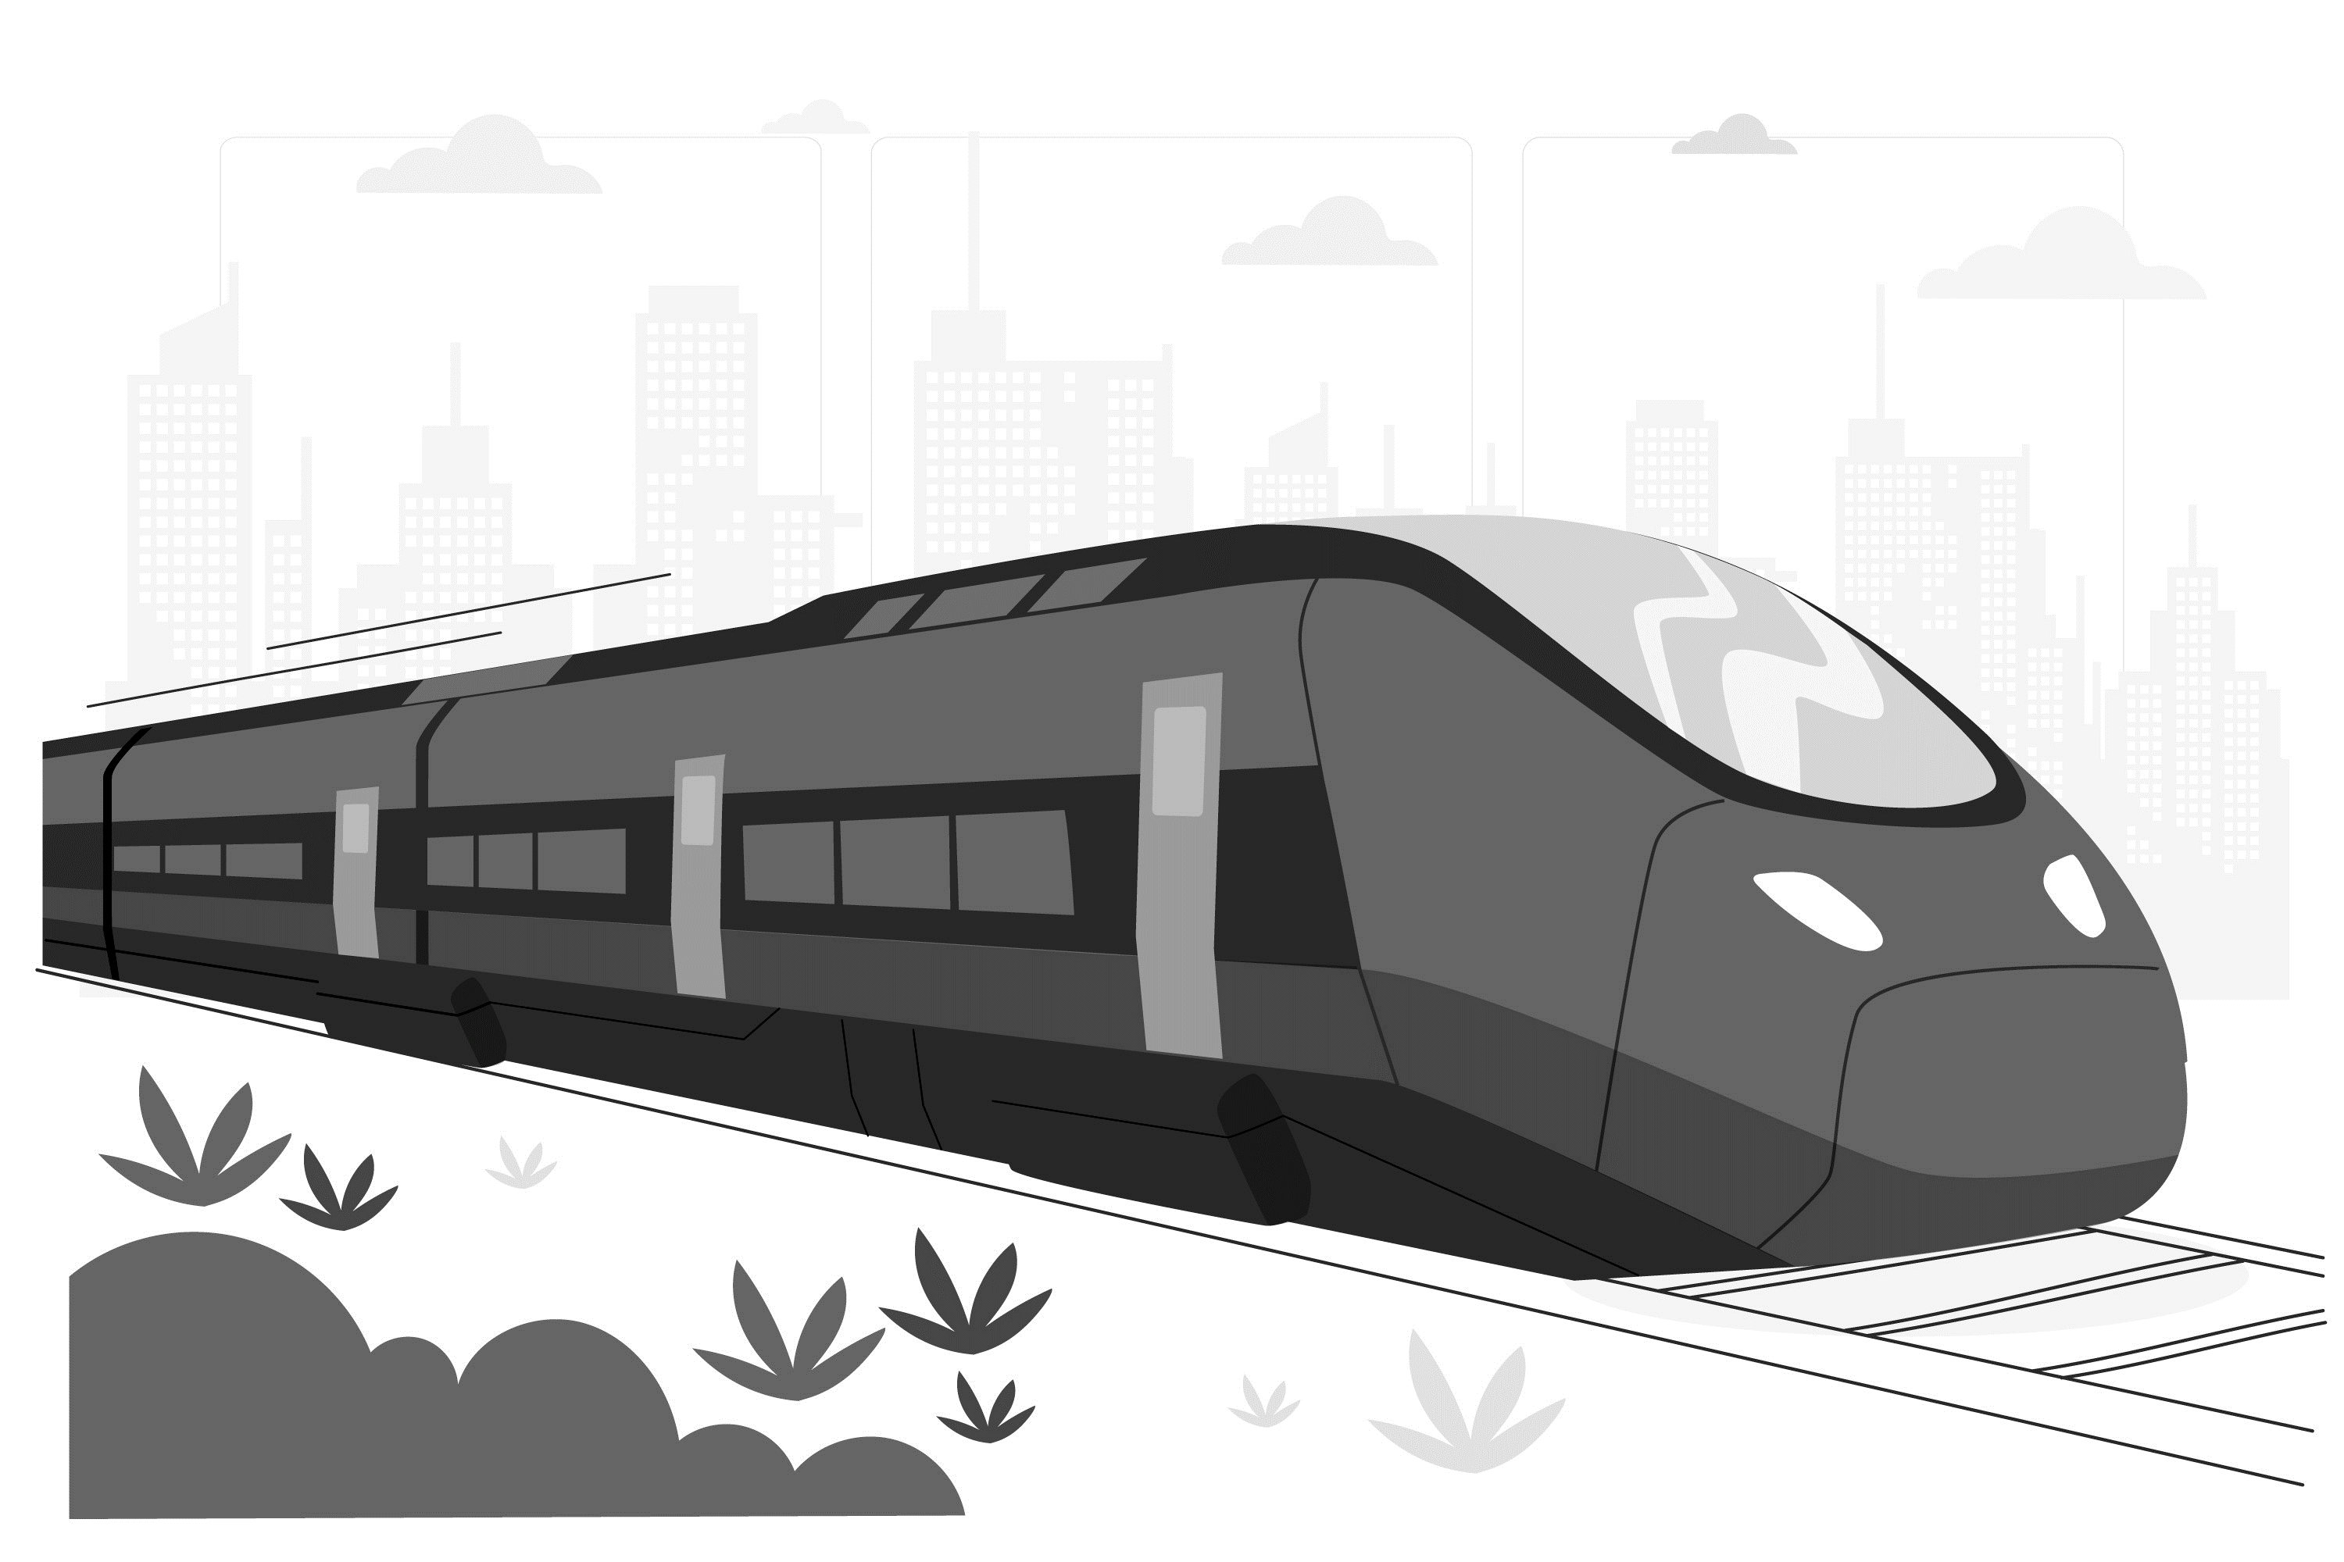


SMART INDIA HACKATHON 2024
TITLE PAGE
Problem Statement ID – SIH1710
Problem Statement Title – Enhancing Navigation for
Railway station facilities and Locations
Theme – Transportation and Logistics
PS Category – Software
Team ID – 10286
Team Name – Maverick Minds

Slide 2

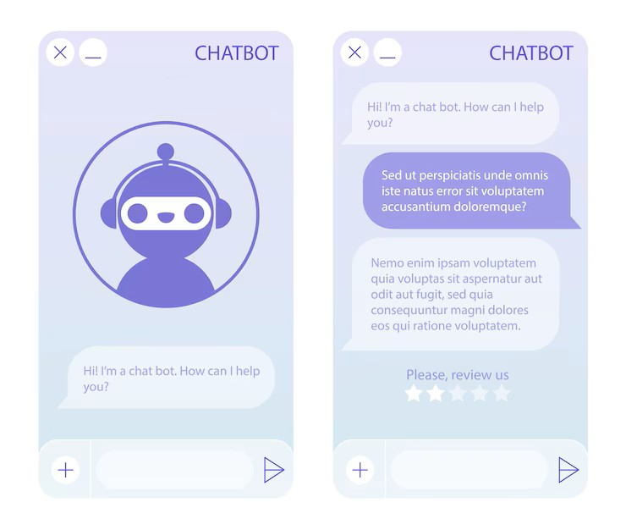

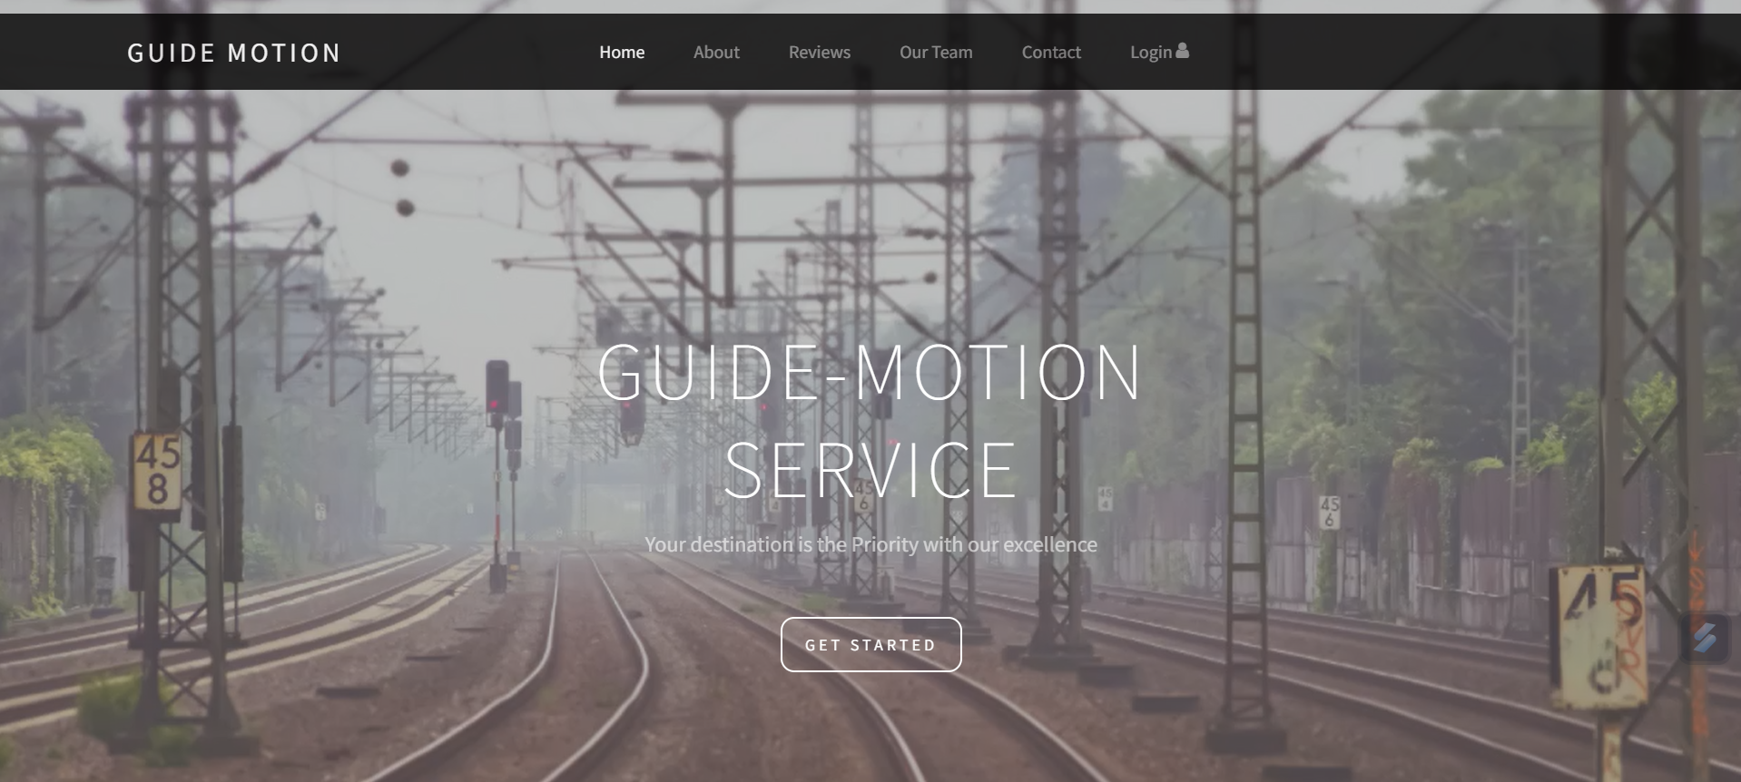
Idea/Proposal
We are proposing an application that features a detailed navigation system with maps and for smooth station navigation, supported by an AI chat assistant.
Features of
Web-App
Multilingual
DGPS surveying
Powerful Database
AI Chat-Bot
Logistics
Features of Web-App
By Dev
Powerful Database
By Railway
IRCTC Support
A.I. Chat-Bot
Multilingual
DGPS Surveying
Logistics

Slide 3
Technical Potential of Guide Motion
Established Railway Station
Simple App Design
DGPS Surveying System
Technical Feasibility
DGPS surveying is a well-established technology
Developing a user-friendly mobile app is feasible
Operational Feasibility
Easy integration with existing infrastructure
Financial Viability
Relatively low development and implementation costs
Reduces physical signage and printed materials
Social and Environmental Viability
Scalable and flexible design
Minimal hardware installations needed
Potential revenue through advertising and partnerships
Promotes social inclusion and equality
Feasibility and Viability
Chat-Bot
Multilingual
Logistic Services

Slide 4
Path to Resolution
Hustle free Station
Limited Revenue
Navigation
Surveying System
User-Friendly
App-Design
Recruitment System
Dedicated User-Accounts management system
Bookings and
Employee Lists
Feedback-driven Implementation
Instant Medical Support
Problem
Navigation difficulties
Congestion and delays
Solutions
DGPS-based orientation system
Mobile app with facility locations
Confusion at the depot
Inaccessibility
Limited revenue
Inefficient signage
Simple, user-friendly system design
Inclusive mobile app design
Targeted advertising and partnerships
Digital signage through the mobile app

Slide 5
Technical Approach
Guide
Motion
Working
This technology stack allows for fast and efficient development of our web application, with a focus on scalability, flexibility, and ease of maintenance.
Desktop
Laptop
Smartphone
IRCTC
Railway Station

